Slide 1
RaspberryPi Kiosk
The Secured Edition…

Slide 2
Agenda
How did this start?
Pretend I am an Admin again (I’ll Share my process/procedures notes)
Next steps (Security Support) for UW and others?
Notes:
Soundtransit OnebusAway
OneDrive doc
How to use this info to help others secure RaspberryPis

Slide 3
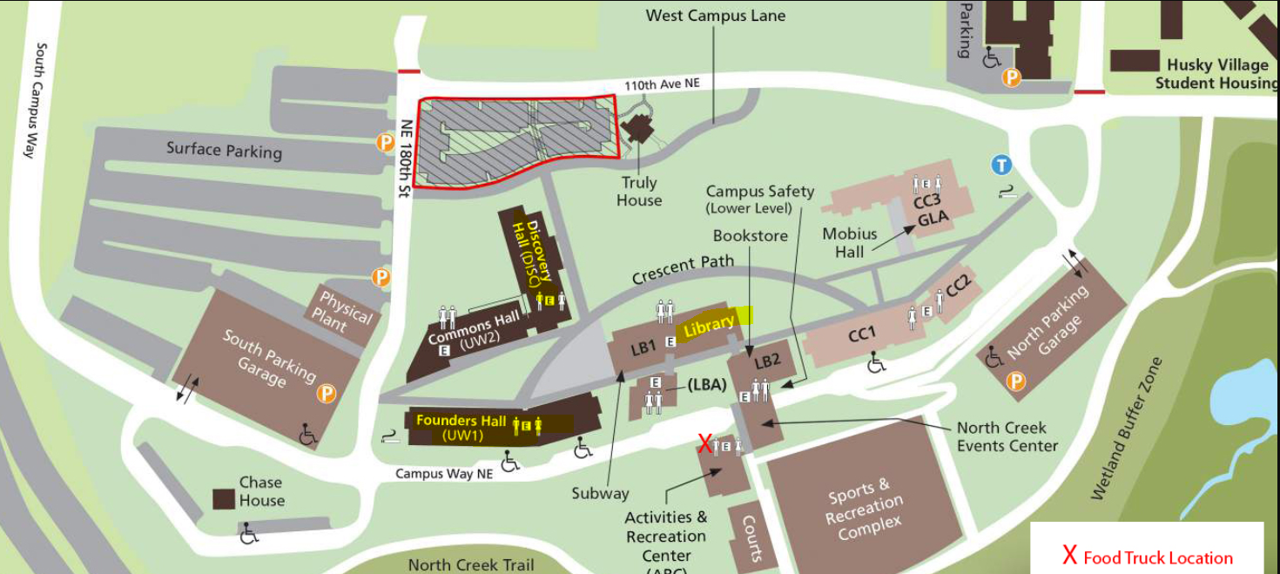
Current Layout
3 Bldgs –Library, DiscoveryHall, and UW1
Equipment: TVs, Windows PCs, and Vendor support

Slide 4
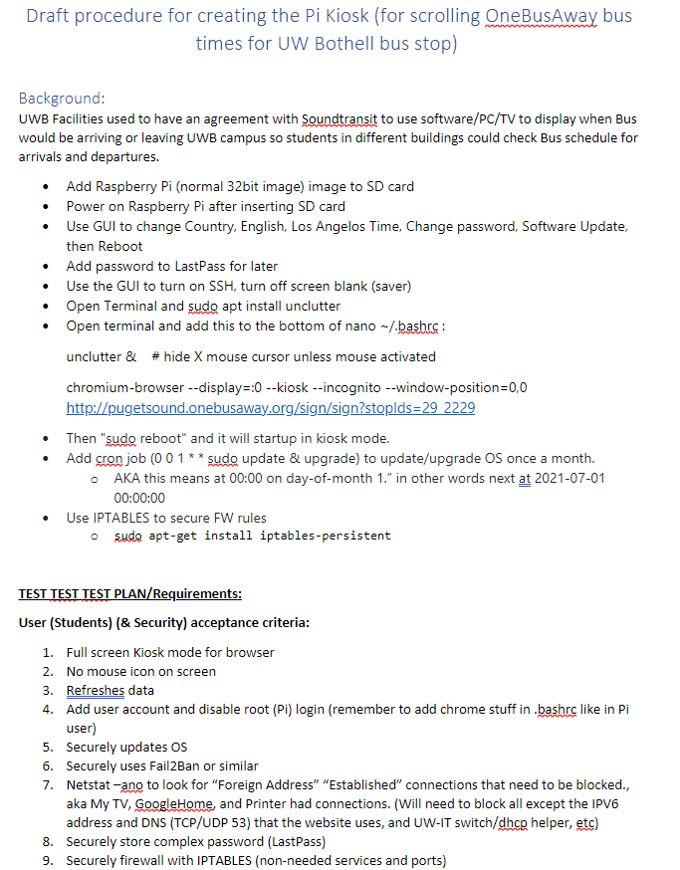
–Be an Admin again
Lots of stuff here to look at later…
Notes:
https://uwnetid-my.sharepoint.com/:w:/r/personal/moorej1_uw_edu/_layouts/15/Doc.aspx?sourcedoc=%7B3906779A-60B6-46CB-9873-6DE4F486DE59%7D&file=EditCopy-RaspberryPi%20Kiosk1.docx&action=default&mobileredirect=true

Slide 5
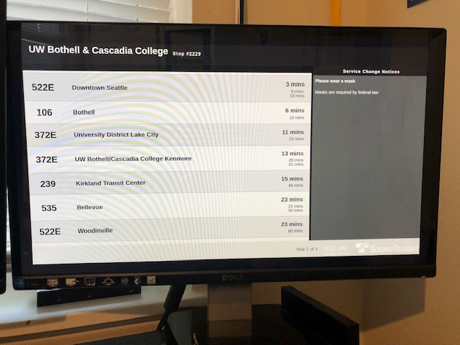
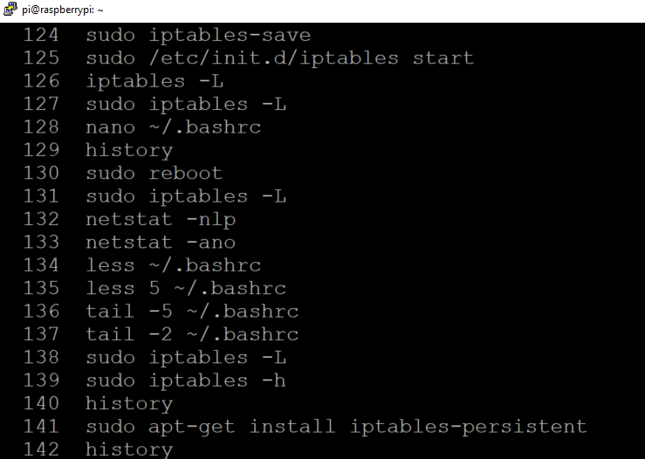
Final Product from student/staff view
OneBusAway:
Bash History:

Slide 6
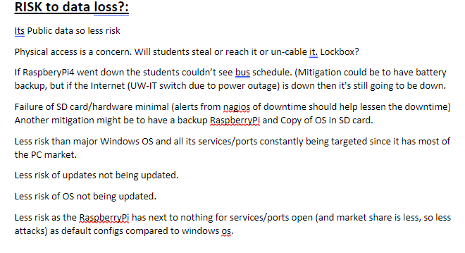
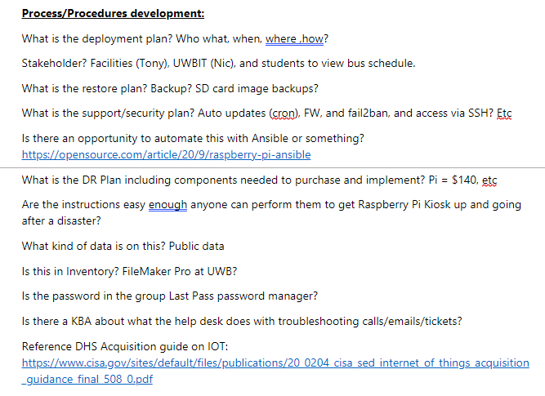
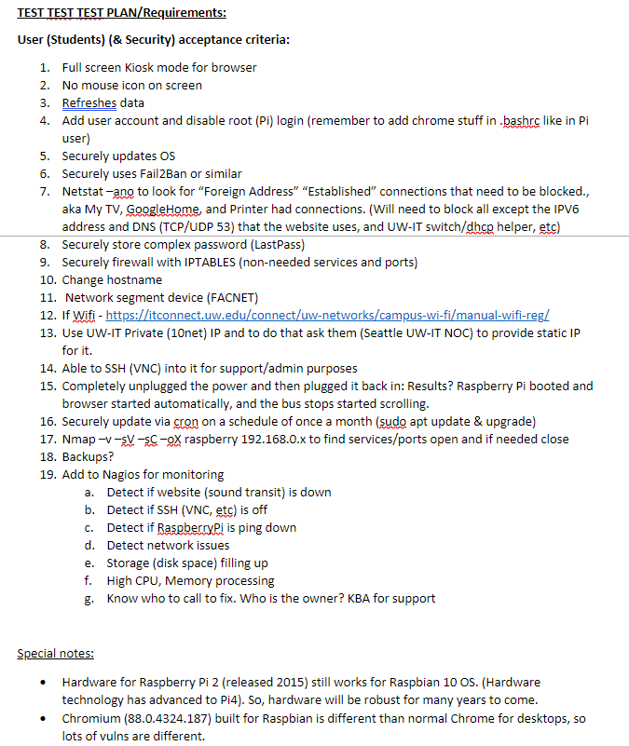
Procedures/Process?

Slide 7
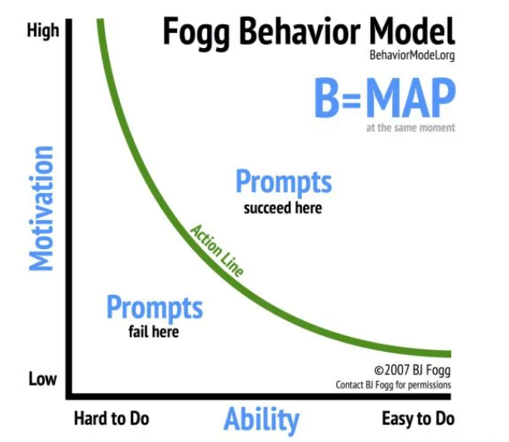
Prompts? Easy to do? Motivation?
Hoping to help other Admins to create a more secure RaspberryPi based on this Model.

Slide 8
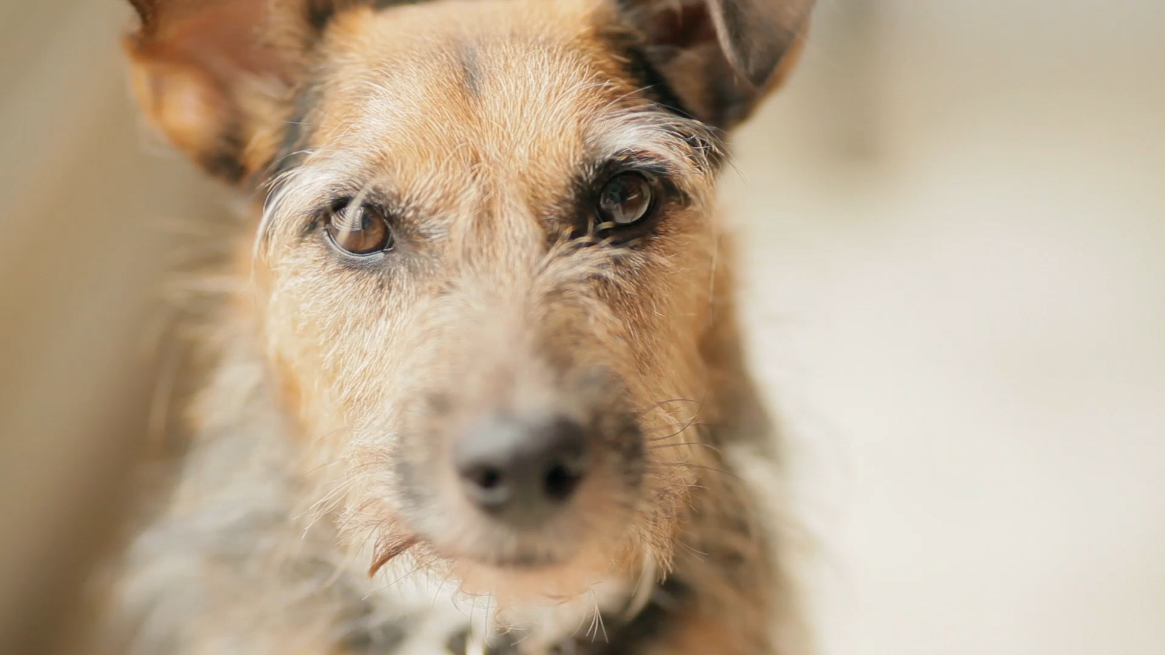
What can CISO office do easily to help guidance /support?

Slide 9
Questions…
Next steps ideas?
Notes:
https://uwnetid-my.sharepoint.com/:w:/r/personal/moorej1_uw_edu/_layouts/15/Doc.aspx?sourcedoc=%7B3906779A-60B6-46CB-9873-6DE4F486DE59%7D&file=EditCopy-RaspberryPi%20Kiosk1.docx&action=default&mobileredirect=true

Slide 10


